Slide 1
Predicting the direction of stock market prices using random forest
Instructor: Nguyen Chi Thien
Candidates:
Phan Ly Phuong Nghi
Nguyen Phuc Nghi

Slide 2
Introduction
Predicting trends in stock market prices has been an area of interest for researchers for many years due to its complex and dynamic nature
Market risk, strongly correlated with forecasting errors, needs to be minimized to ensure minimal risk in investment
We propose a novel way to minimize the risk of investment in stock market by predicting the direction of a stock using a class of powerful machine learning algorithms known as ensemble learning

Slide 3
Outline
Techniques and Algorithm
Methodology and Analysis
Data Preprocessing and Future Extraction
Test for linear separability
Random Forest
Result and Conclusion

Slide 4
Techniques use to Predict the stock
(1) Technical Analysis
(2) Time Series Forecasting
(3) Machine Learning and Data Mining (Hellstrom and Holmstromm (1998))
(4) modeling and predicting volatility of stocks using differential equations (Saha, Routh and Goswami (2014))
This topic is focuses on the third approach method since the data is too big for traditional methods

Slide 5
Algorithms
Several algorithms have been used in stock prediction such as SVM, Neural Network, Linear Discriminant Analysis, Linear Regression, KNN and Naive Bayesian Classifier. Literature survey revealed that SVM has been used most of the time in stock prediction research.
SVM reported the highest accuracy of 79.3%. In Xinjie (2014), the authors have used 3 stocks (AAPL, MSFT, AMZN) that have time span available from 2010-01-04 to 2014-12-10.

Slide 6
Controversy
The use of prediction algorithms to determine future trends in stock market prices contradict a basic rule in finance known as the Efficient Market Hypothesis (Fama and Malkiel (1970)).

Slide 7
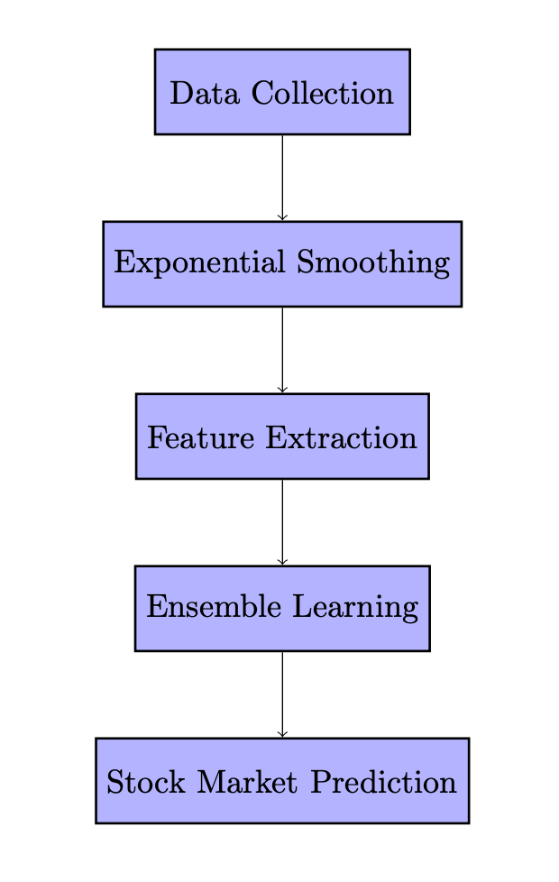
Methodology and Analysis
Proposal of the Methodology.
The learning algorithm used in our paper is random forest. The time series data is acquired, smoothed and technical indicators are extracted. Technical indicators are parameters which provide insights to the expected stock price behavior in future. These technical indicators are then used to train the random forest.

Slide 8
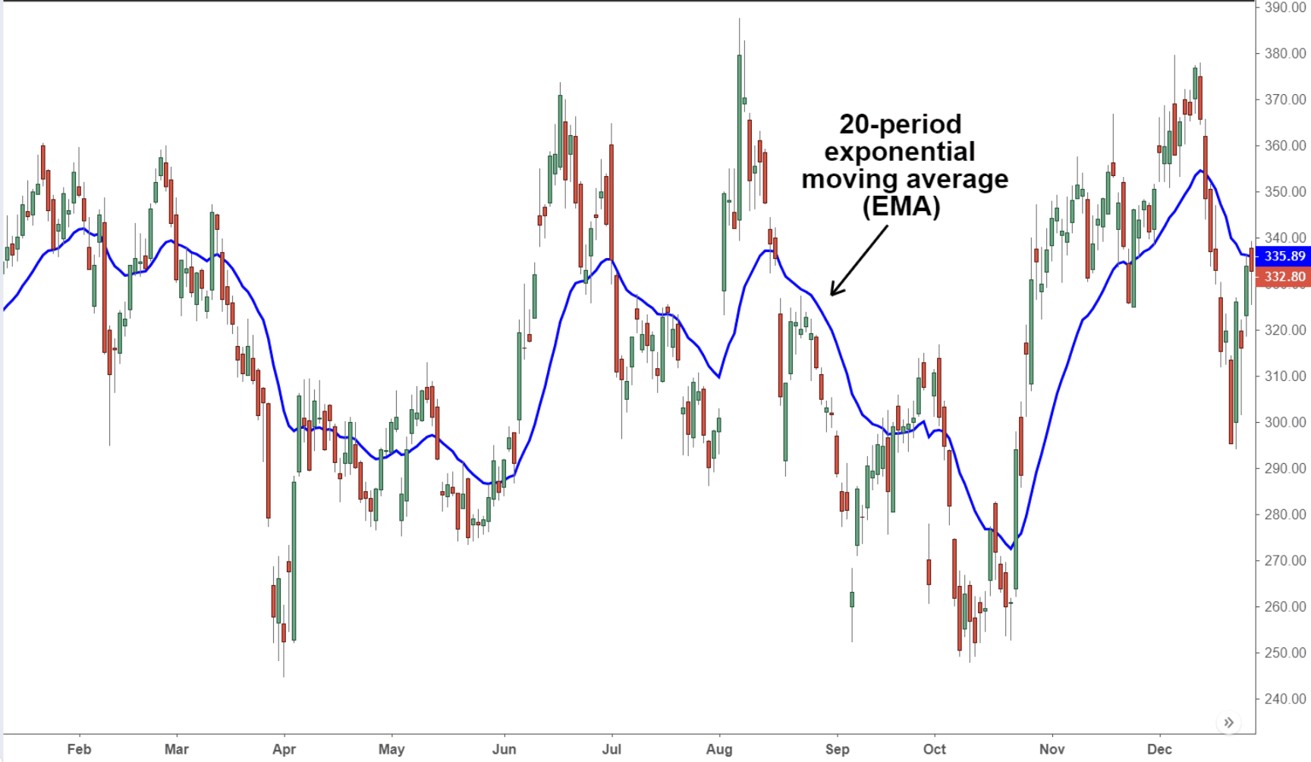
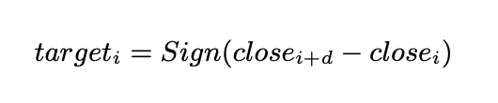
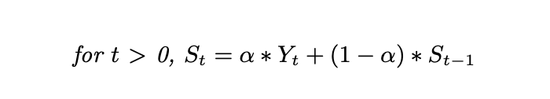
Data Preprocessing
The time series historical stock data is first exponentially smoothed.
Exponential smoothing applies more weightage to the recent observation and exponentially decreasing weights to past observations
This smoothing removes random variation or noise from the historical data allowing the model to easily identify long term price trend in the stock price behavior.
When the value of target_i is +1, it indicates that there is a positive shift in the price after d days and -1 indicates that there is a negative shift after d days.

Slide 9
Feature Extraction
Technical Indicators are important parameters that are calculated from time series stock data that aim to forecast financial market direction. They are tools which are widely used by investors to check for bearish or bullish signals.
MACD of stock price (Moving Average Convergence/Divergence Oscillator)

Slide 10
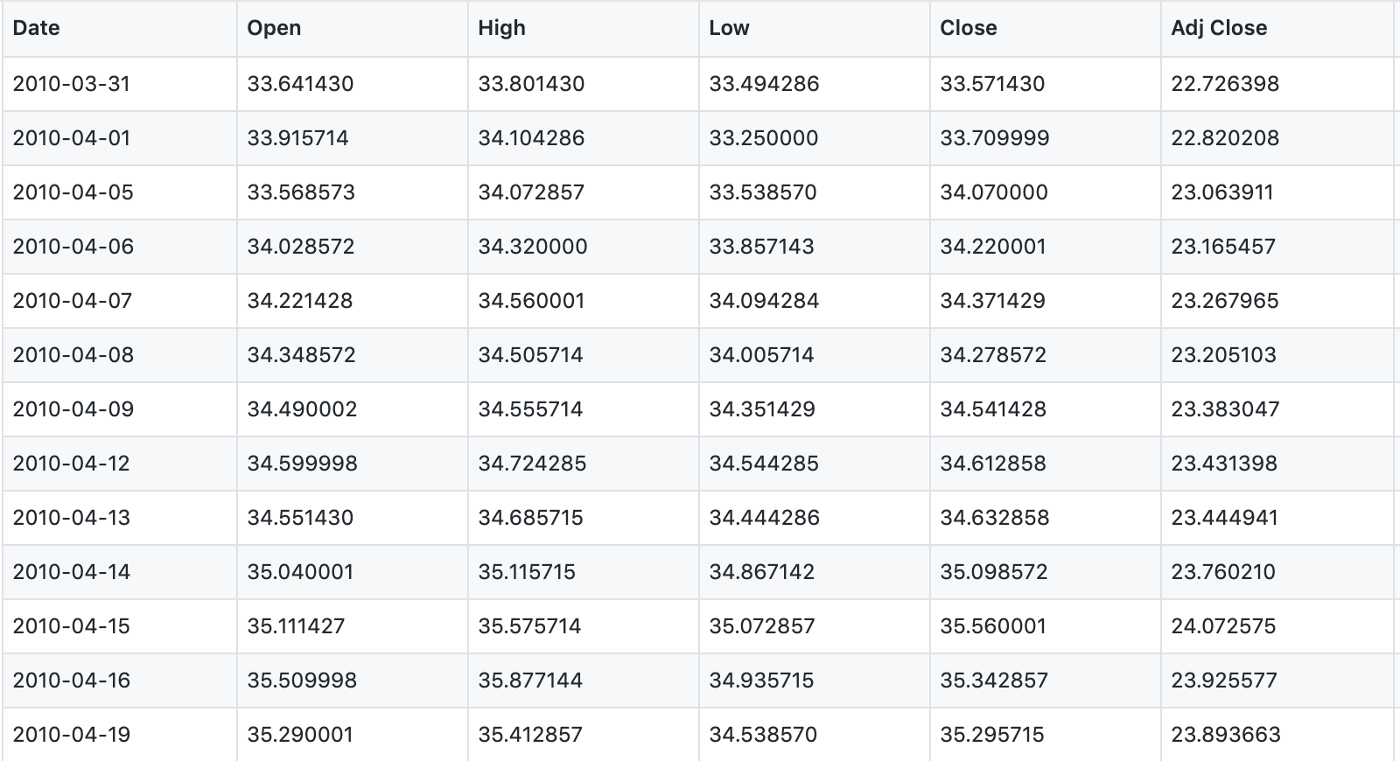
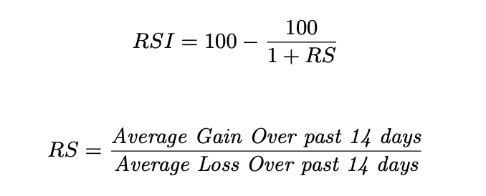
Feature Extraction
Relative Strength Index (RSI)
RSI is a popular momentum indicator which determines whether the stock is overbought or oversold.

Slide 11
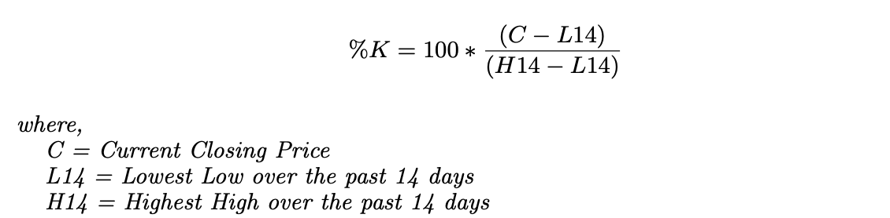
Feature Extraction
Stochastic Oscillator (%K)
Stochastic Oscillator follows the speed or the momentum of the price. As a rule, momentum changes before the price changes. It measures the level of the closing price relative to low-high range over a period of time.

Slide 12
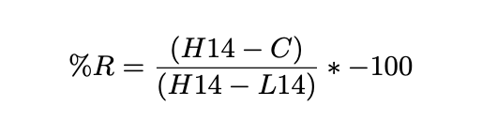
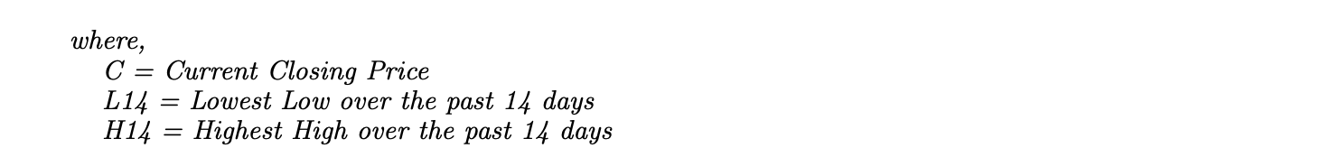
Feature Extraction
Williams %R
Williams %R ranges from -100 to 0. When its value is above -20, it indicates a sell signal and when its value is below -80, it indicates a buy signal.

Slide 13
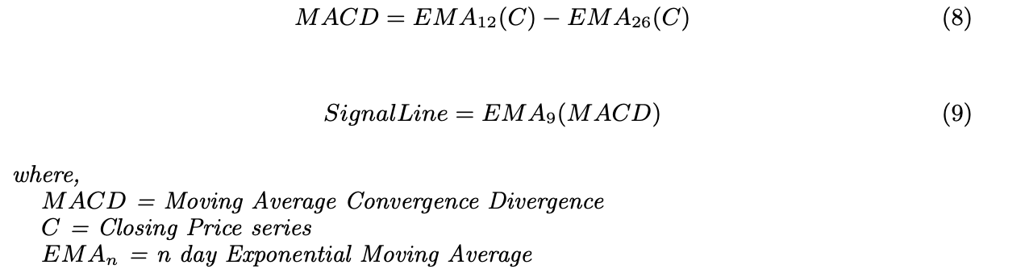
Feature Extraction
Moving Average Convergence Divergence
EMA stands for Exponential Moving Average. When the MACD goes below the SingalLine, it indicates a sell signal. When it goes above the SignalLine, it indicates a buy signal.

Slide 14
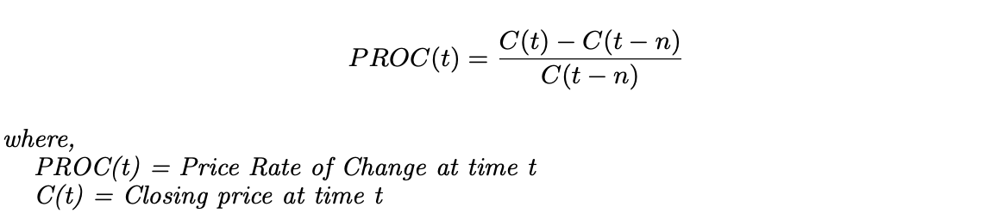
Feature Extraction
Price Rate of Change
It measures the most recent change in price with respect to the price in n days ago.

Slide 15
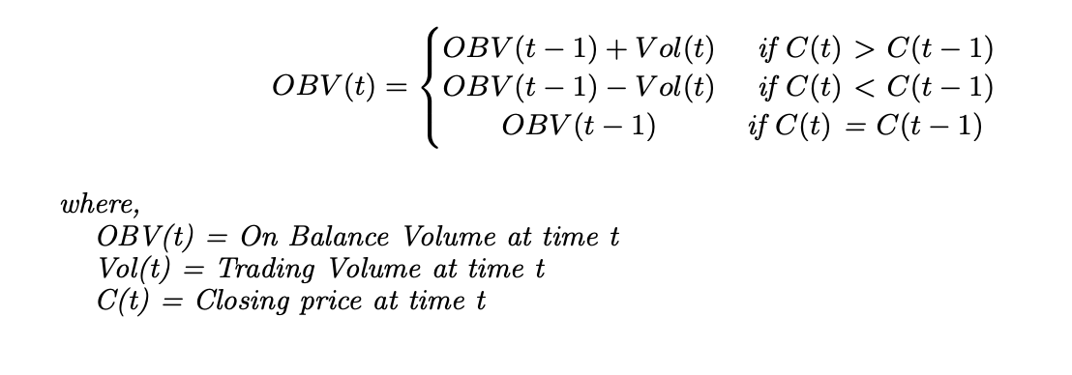
Feature Extraction
On Balance Volume (OBV)
This technical indicator is used to find buying and selling trends of a stock.

Slide 16
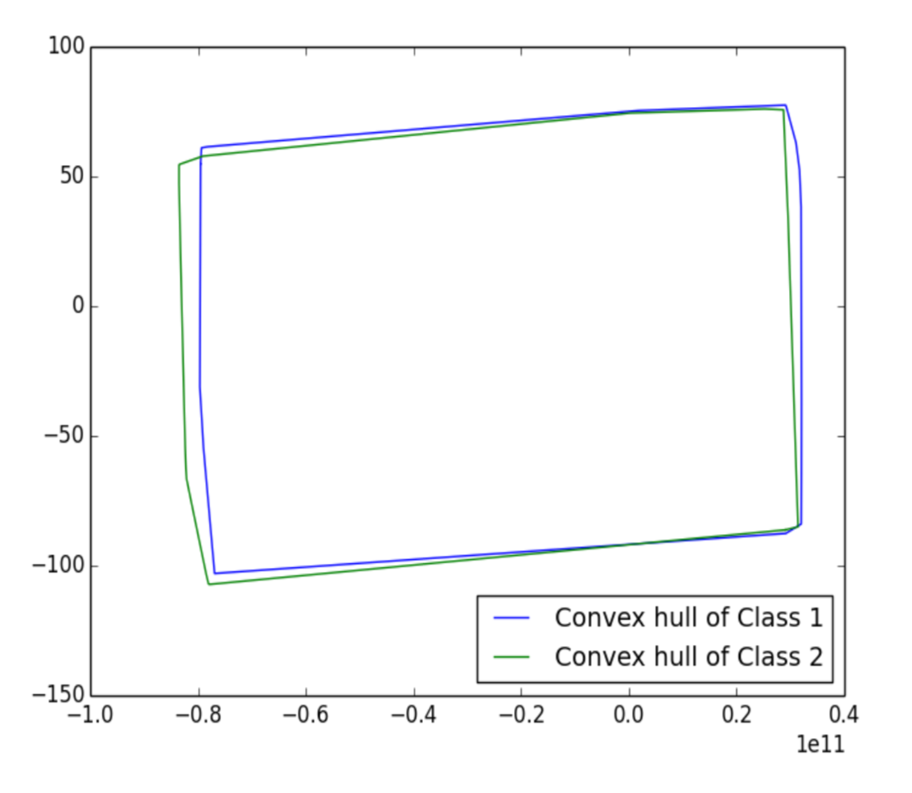
Test for linear separability
Before feeding the training data to the Random Forest Classifier, the two classes of data are tested for linear separability by finding their convex hulls.
LS is a property of two sets of data points where the two sets are said to be linearly separable if there exists a hyperplane such that all the points in one set lies on one side of the hyperplane and all the points in other set lies on the other side of the hyperplane.

Slide 17
Random Forest
Decision trees that are grown really deep to learn highly irregular patterns tend to overfit the training sets. A slight noise in the data may cause the tree to grow in a completely different manner. This is because of the fact that decision trees have very low bias and high variance. Random Forest overcomes this problem by training multiple decision trees on different subspace of the feature space at the cost of slightly increased bias. This means none of the trees in the forest sees the entire training data. The data is recursively split into partitions. At a particular node, the split is done by asking a question on an attribute. The choice for the splitting criterion is based on some impurity measures such as Shannon Entropy or Gini impurity.

Slide 18
Random Forest
Advantages
Do both classification and regression tasks
Handle the missing values and maintains accuracy for missing data.
Won’t overfit the model
Handle large dataset with higher dimensionality
Disadvantages
Good job at classification but not as good as for regression
Have a little control on what the model does

Slide 19
Random Forest in Stock Prediction - Definitions
We define a classification tree where each node is endowed with a binary decision if x_{i} <= k or not ; where k is some threshold. The topmost node in the classification tree contains all the data points and the set of data is subdivided among the children of each node as defined by the classification. Assume there are n data points D = {(x_{i} , y_{i})}_{i=1}^{n}
Let us represent h_{k}(x) = h(x|θ_{k}) implying decision tree k leading to a classifier h_{k}(x).

Slide 20
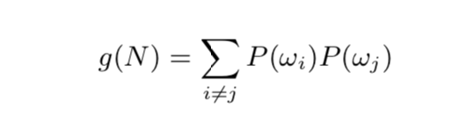
The choice for the splitting criterion - Gini impurity
There are many kinds for splitting:
where P(ωi) is the proportion of the population with class label i

Slide 21
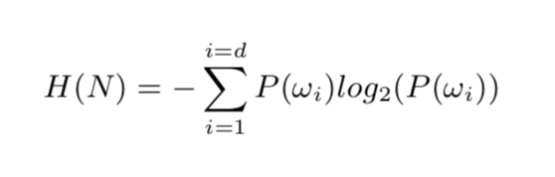
The choice for the splitting criterion Shannon entropy
The entropy in a node N can be calculated as follows
where d is number of classes considered and P(ωi) is the proportion of the population labeled as i.

Slide 22
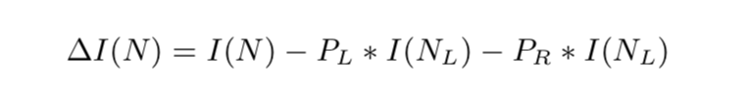
The choice for the splitting criterion - heuristic approach
The information gain due to a split can be calculated as follows:
where I(N) is the impurity measure (Gini or Shannon Entropy) of node N, PL is the proportion
of the population in node N that goes to the left child of N after the split and similarly, PR is the
proportion of the population in node N that goes to the right child after the split. NL and NR are the left and right child of N respectively.

Slide 23
Random Forest Algorithm
At the heart of all ensemble machine learning algorithms is bagging. This method improves the stability and accuracy of learning algorithms. At the same time, it also reduces variance and overfitting which is a common problem while constructing Decision trees.
Given a sample dataset D of size n, bagging generates B new sets of size n’. With this knowledge, we can now summarize the algorithm of random forest classifier as follows

Slide 24
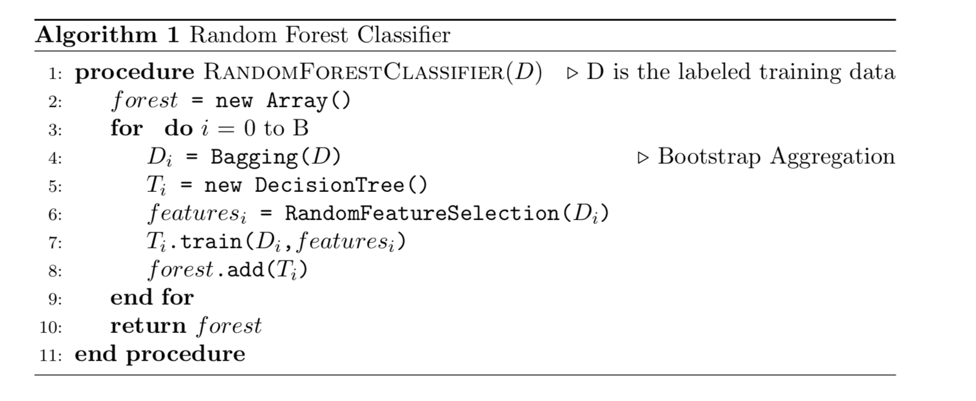
Psuedocode

Slide 25

Visualization

Slide 26
Result
Using the prediction result produced by this model to decide whether to buy or sell stock
The prediction is +1, which means the price is expected to rise
The prediction is -1, which means the price is expected to fall
Any wrong prediction can cause the trader a great deal of money
The model should be evaluated for its robustness
The params that are used to evaluated the robustness are accurary, precision, recall and specificity

Slide 27
Result
Accuracy measures the portion of all testing sample classified correctly
Recall measures the ability of a classifier to correctly identify positive labels
Specificity measures the classifier’s ability to correctly identify negative labels
Precision measures the proportion of all correctly identified samples in a population of samples which are classified as positive label

Slide 28
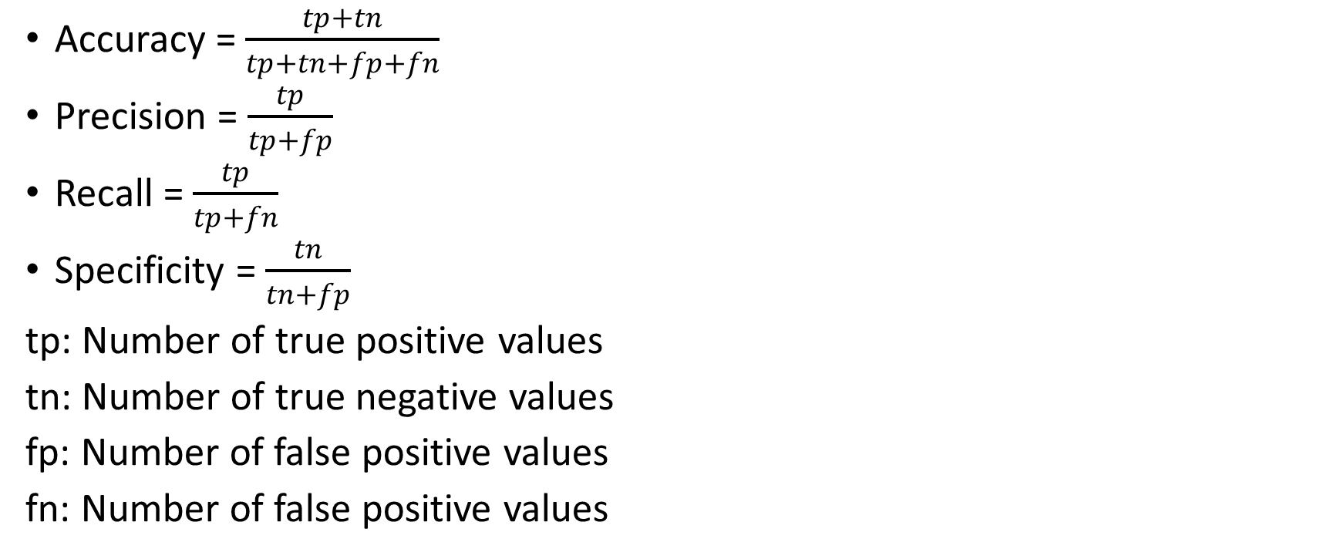
Result
Accuracy = $\frac{tp+tn}{tp+tn+fp+fn}$
Precision = $\frac{tp}{tp+fp}$
Recall = $\frac{tp}{tp+fn}$
Specificity = $\frac{tn}{tn+fp}$
tp: Number of true positive values
tn: Number of true negative values
fp: Number of false positive values
fn: Number of false positive values

Slide 29
Result
Trading Period | Accurary (%) | Precision | Recall | Specificity
1 month | 88.264 | 0.89263 | 0.90724 | 0.84848
2 months | 93.065 | 0.94154 | 0.93858 | 0.91973
3 months | 94.533 | 0.94548 | 0.96120 | 0.92341
Result for Apple dataset
Trading Period | Accurary (%) | Precision | Recall | Specificity
1 month | 84.717 | 0.85531 | 0.87637 | 0.80968
2 months | 90.831 | 0.91338 | 0.93099 | 0.87659
3 months | 92.543 | 0.93128 | 0.94557 | 0.89516
Result for GE dataset
Trading Period | Accurary (%) | Precision | Recall | Specificity
1 month | 86.8396 | 0.881818 | 0.870736 | 0.865702
2 months | 90.6433 | 0.910321 | 0.92599 | 0.880899
3 months | 93.9664 | 0.942004 | 0.950355 | 0.926174
Result for Samsung dataset

Slide 30
Result
Receiver Operating Characteristicis a graphical method to evaluate the performance of a binary classifier
ROC curves corresponding to AAPL dataset

Slide 31
Result
ROC curves corresponding to GE dataset

Slide 32
Result
ROC curves corresponding to Samsung dataset

Slide 33
Comparation
Result from Dai and Zhang 2013
Result from model using RF

Slide 34
Conclusion
Predicting stock market due to its non linear, dynamic and complex nature is really difficult
However in the recent years, machine learning techniques have proved effective in stock forecasting
Many algorithms such as SVM, ANN have been studied for robustness in predicting stock market
Use Random Forest classifier to build predictive model to get impressive results

Slide 35
Conclusion
The model is proved to be really robust in predicting future direction of stock movement
For 3 datasets AAPL, GE and Samsung, accurary in range 85-95% for long term prediction
ROC curves were also plotted to evaluate the model
The model can be used for devising new strategies for trading or to perform stock portfolio management, changing stocks according to trends prediction

Slide 36
Thank you

